Slide 1
Digital Portfolio
STUDENT NAME: YOKARAJA T.R.S
REGISTER NO AND NMID:222407881/ 9091C32889951989436481DD105445A7
DEPARTMENT: DATA SCIENCE
COLLEGE: TAGORE COLLEGE POF ARTS AND SCIENCE/ UNIVERSITY OF MADRAS

Slide 2

portfolio
Custom-coded personal portfolio showcasing skills, projects, and About Me section.
Design: Modern dark theme with teal & purple accents, glowing effects, and radial gradient background.
Features: Responsive navigation (Home, About Me, Skills, Projects, Contact), card-based skills section, project listings with icons.
Interactive Elements: Project modals to preview work (e.g., GreenBin) without leaving the page.
Highlights technical expertise, design sensibility, and personal brand.

Slide 3


AGENDA
Problem Statement
Project Overview
End Users
Tools and Technologies
Portfolio design and Layout
Features and Functionality
Results and Screenshots
Conclusion
Github Link
3/21/2024 Annual Review

Slide 4

PROBLEM STATEMENT
Need to showcase professional skills, projects, and design philosophy effectively.
Highlight technical expertise, creativity, and data-driven projects.
Present a clear personal brand and portfolio identity to potential collaborators or employers.

Slide 5

PROJECT OVERVIEW
Portfolio Website – A custom-coded platform that presents skills, projects, and background.
Designed with a modern dark theme, teal & purple accents, and responsive layouts.
Features navigation, interactive sections, skill cards, and project showcases

Slide 6

WHO ARE THE END USERS?
Viewers/Employers: Recruiters or collaborators reviewing skills & projects.
Peers/Students: Learn from projects and design approach.
Self: Showcase technical growth and design thinking.

Slide 7
TOOLS AND TECHNIQUES
HTML5 & CSS3 → Structure, gradients, hover effects, dark theme.
JavaScript → Navigation, interactive modals, responsive behavior.
Fonts & Icons → Poppins & Playfair Display, Font Awesome icons.
Design Principles → Dark mode, grid layout, card-based UI, smooth transitions.

Slide 8
POTFOLIO DESIGN AND LAYOUT
Header: Portfolio title and navigation.
Sections: Home, About Me, Skills, Projects, Contact.
Skills: Card-based with icons, hover effects.
Projects: Listed with icons; includes GreenBin as one project.
Responsive: Works across desktop and mobile.
8

Slide 9
FEATURES AND FUNCTIONALITY
Home → Introduction and philosophy.
About Me → Background, education, and professional focus.
Skills → Java, Python, Video Editing, HTML & Web Development.
Projects → Smart Data Visualizer, Student Success Predictor, GreenBin, Portfolio Website.
Contact → Email & phone for collaboration.
Interactive Modal → Preview GreenBin project without leaving page

Slide 10
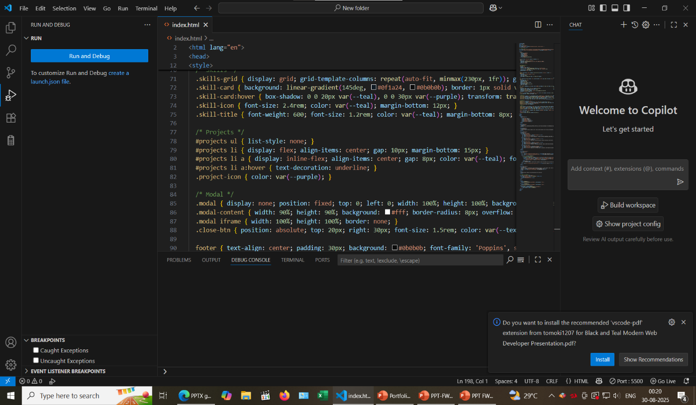
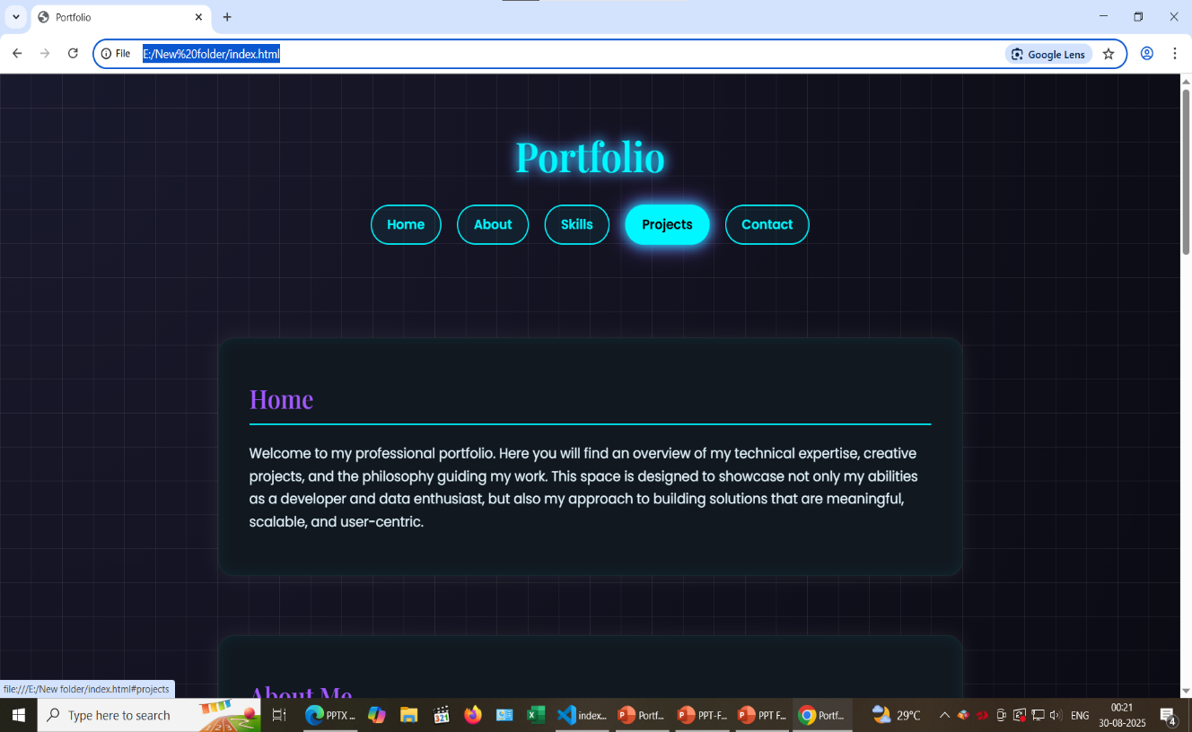
RESULTS AND SCREENSHOTS
3/21/2024 Annual Review
10

Slide 11
CONCLUSION
Portfolio emphasizes personal expertise and professional growth.
GreenBin is one example of real-world, socially impactful work.
Long-term goal: Build more projects that combine technical skills and design thinking.
Call to Action: Connect, collaborate, and explore new opportunities.
11

